Slide 1
Kalman Filter
Dr. Pradeep Bilurkar
Notes:
This template can be used as a starter file for presenting training materials in a group setting.
Sections
Right-click on a slide to add sections. Sections can help to organize your slides or facilitate collaboration between multiple authors.
Notes
Use the Notes section for delivery notes or to provide additional details for the audience. View these notes in Presentation View during your presentation.
Keep in mind the font size (important for accessibility, visibility, videotaping, and online production)
Coordinated colors
Pay particular attention to the graphs, charts, and text boxes.
Consider that attendees will print in black and white or grayscale. Run a test print to make sure your colors work when printed in pure black and white and grayscale.
Graphics, tables, and graphs
Keep it simple: If possible, use consistent, non-distracting styles and colors.
Label all graphs and tables.

Slide 2
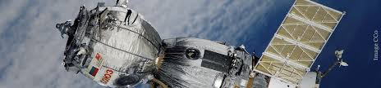

Kalman Filter
The most famous early use of the Kalman filter was in the Apollo navigation computer that took Neil Armstrong to the moon, and (most importantly) brought him back.
Today, Kalman filters are at work in every satellite navigation device, every smart phone, and many computer games.

Slide 3
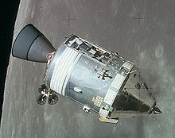
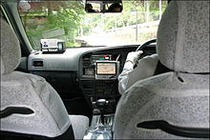
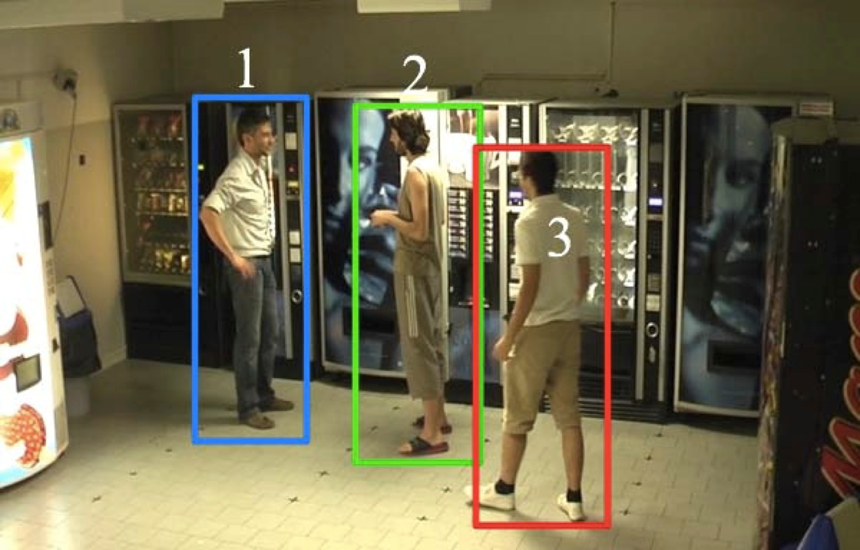
Applications
http://en.wikipedia.org/wiki/Gps
http://en.wikipedia.org/wiki/Apollo_program
http://www.lorisbazzani.info/research-2/

Slide 4
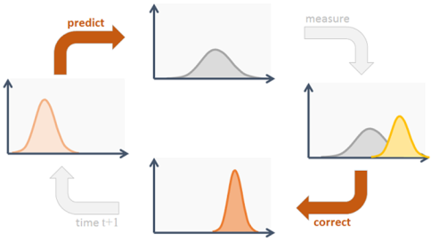
Kalman Filter
A Kalman filter is an optimal recursive data processing algorithm
The Kalman filter incorporates all information that can be provided to it. It processes all available measurements, regardless of their precision, to estimate the current value of the variables of interest
Computationally efficient due to its recursive structure
Assumes that variables being estimated are time dependent
Linear Algebra application

Slide 5
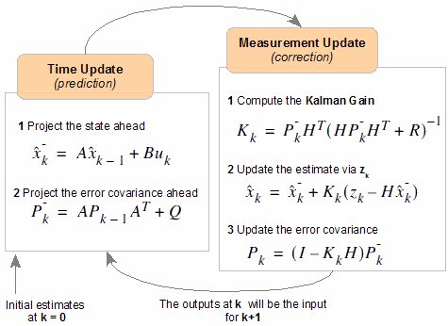
Process Steps

Slide 6
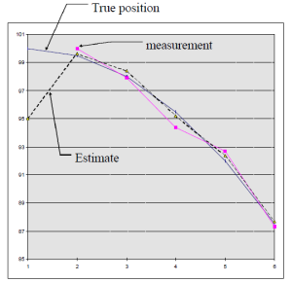
Kalman Filter
Kalman Filter (aka linear quadratic estimation (LQE)) is an algorithm which can be used to estimate precise states of a moving object by feeding a series of noisy sensor inputs over time.
Two main operations.
Estimating the next state of the machine
Correcting the estimated state with actual measurements

Slide 7

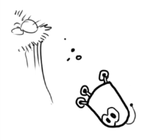
Robotic Movement
You’ve built a little robot that can wander around in the woods, and the robot needs to know exactly where it is so that it can navigate.
Robot has a state xk→, which is just a position and a velocity:
xk→=(p⃗ ,v⃗ )
Our robot also has a GPS sensor, which is accurate to about 10 meters, which is good, but it needs to know its location more precisely than 10 meters.
So GPS by itself is not good enough.
The GPS sensor tells us something about the state, but only indirectly, and with some uncertainty or inaccuracy.
Our prediction tells us something about how the robot is moving, but only indirectly, and with some uncertainty or inaccuracy.

Slide 8
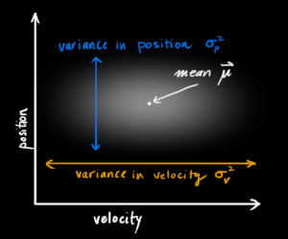
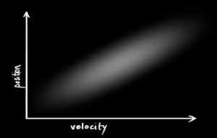
Kalman Filter Perspective
Simple state having only position and velocity
We don’t know what the actual position and velocity are
The Kalman filter assumes that both variables (position and velocity) are random and Gaussian distributed.
Each variable has
a mean value μ, which is the centre of the random distribution (and its most likely state), and
a variance σ², which is the uncertainty
more information
This correlation is captured by something called a covariance matrix.

Slide 9
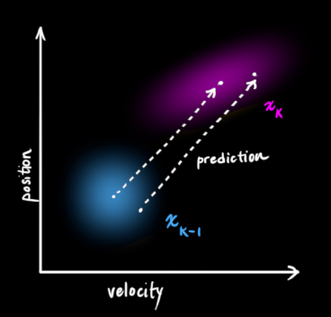

Describing the problem with matrices
We’re modelling our knowledge about the state as a Gaussian blob
We need two pieces of information at time k:
We’ll call our best estimate (the mean),
and its covariance matrix P_{k}.
Next, we need some way to look at the current state (at time k-1) and predict the next state at time k. Remember, we don’t know which state is the “real” one, but our prediction function doesn’t care. It just works on all of them, and gives us a new distribution:

Slide 10

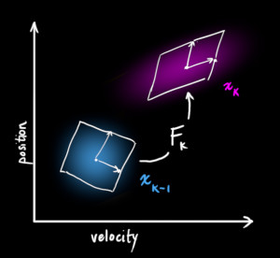
Prediction Matrix
Next, we need some way to look at the current state (at time k-1) and predict the next state at time k.
We can represent this prediction step with a matrix, Fk:
It takes every point in our original estimate and moves it to a new predicted location, which is where the system would move if that original estimate was the right one.

Slide 11
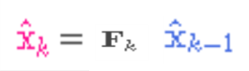
State Prediction Matrix
Using Basic Kinematic Formula
P_{k} is position at instance k
By our Definition
Its is Prediction Matrix that gives us our next state
How to update the covariance matrix ?

Slide 12
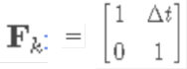
Update Covariance Matrix
Question to ask is, If we multiply every point in a distribution by a matrix A, then what happens to its covariance matrix Σ?
But

Slide 13
External influence (Control Matrix)
There might be some changes that aren’t related to the state itself— the outside world could be affecting the system. e.g acceleration etc..
If we know this additional information about what’s going on in the world, we could stuff it into a vector called u_{k} and add it to prediction as a correction
B_{k} is called the control matrix and u_{k}→ the control vector.
(For very simple systems with no external influence, we could omit these).

Slide 14
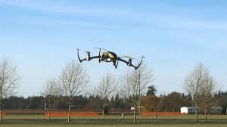
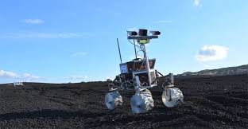
External uncertainty
What about forces that we don’t know about ?
quadcopter, buffeted around by wind
bumps on the ground could slow robot down
Our prediction could be off, if we do not account for these extra forces.
Notes:
Everything is fine if the state evolves based on its own properties. Everything is still fine if the state evolves based on external forces, so long as we know what those external forces are.

Slide 15
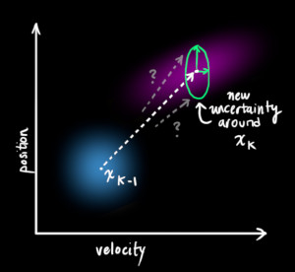
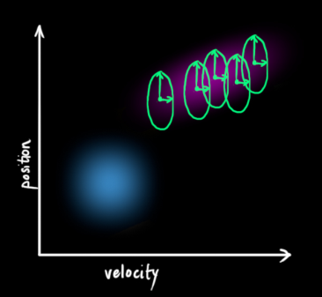
External uncertainty -Example
We can model the uncertainty associated with the “world” ,by adding some new uncertainty after every prediction step:

Slide 16
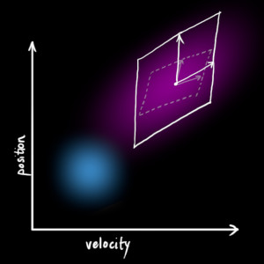
External uncertainty- covariance Qk.
Every state in our original estimate could have moved to a range of states.
Because we like Gaussian blobs so much, we’ll say that each point in x^k−1 is moved to somewhere inside a Gaussian blob with covariance Qk.
Another way to say this is that we are treating the untracked influences as noise with covariance Qk.
This produces a new Gaussian blob, with a different covariance (but the same mean):

Slide 17
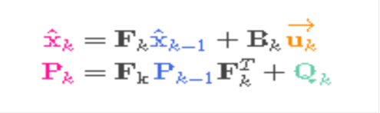
State update formulation
So the new best estimate is a prediction made from previous best estimate, plus a correction for known external influences.
And the new uncertainty is predicted from the old uncertainty, with some additional uncertainty from the environment.
What happens when we get some data from our sensors?

Slide 18
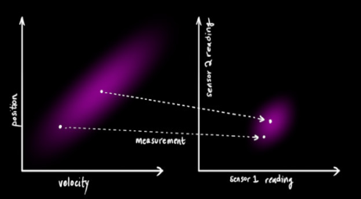
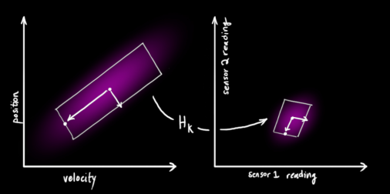
Refining the estimate with measurements
We might have several sensors which give us information about the state of our system.
For the time being it doesn’t matter what they measure; perhaps one reads position and the other reads velocity.
Each sensor tells us something indirect about the state— in other words, the sensors operate on a state and produce a set of readings.

Slide 19


Refining the estimate with measurements
We’ll model the sensors with a matrix
In the usual way distribution of sensor readings would be

Slide 20
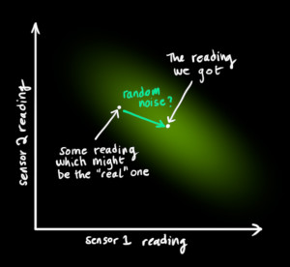
Sensor Noise Rk
We’ll call the covariance of this uncertainty (i.e. of the sensor noise) R_{k}.
The distribution has a mean equal to the reading we observed, which we’ll call z_{k}.

Slide 21
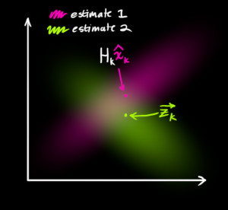
Sensor Noise
So now we have two Gaussian blobs:
One surrounding the mean of our transformed prediction,
One surrounding the actual sensor reading.
Notes:
So what’s our new most likely state? For any possible reading (z1,z2), we have two associated probabilities: (1) The probability that our sensor reading zk→ is a (mis-)measurement of (z1,z2), and (2) the probability that our previous estimate thinks (z1,z2) is the reading we should see.

Slide 22
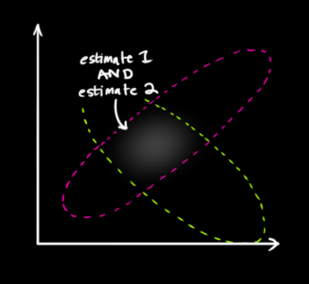
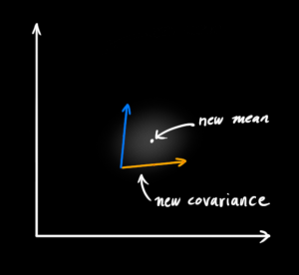
Sensor Noise
If we have two probabilities and we want to know the chance that both are true, we just multiply them together. So, we take the two Gaussian blobs and multiply them:
This looks like another Gaussian blob.
As it turns out, when you multiply two Gaussian blobs with separate means and covariance matrices, you get a new Gaussian blob with its own mean and covariance matrix!

Slide 23

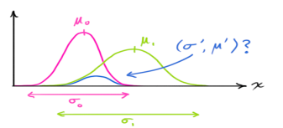
Combining Gaussians
Take note of how you can take your previous estimate and add something to make a new estimate.
And look at how simple that formula is!
If we define K as
K is a matrix called the Kalman gain

Slide 24
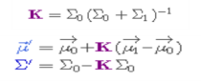

Kalman State Update
We have two distributions: The predicted measurement with
and the observed measurement with
And the Kalman gain is:
We can knock off an
and
Update

Slide 25
Kalman State Update
And the Kalman gain is:
We can knock off an
and
We can estimate the current state taking into account previous state and current measurement
Current Estimate = Previous Estimate + KG (Current Measurement - Previous Estimate)
Error in Current Estimate = (1-KG) * Error in Previous Estimate
Kalman Gain =
(Error in Previous Estimate)
----------------------------------------------------------------
Error in Previous Estimate + Measurement Error
When the gain is zero, measurement has no effect, and we get the original equation relating the current state to the previous.
When the gain is one, the previous state doesn't matter, we get the current state estimation entirely from the current Measurement.

Slide 26
Kalman Filter
Predict
Update

Slide 27
Kalman Filter Model

Slide 28
Kalman Filter Data Flow
Original Error Estimate
Original Estimate
Data Input
Error in Estimate
Error in Data (Measurement)
Previous Estimate
Measured Value
Calculate Kalman Gain
Calculate Current Estimate
Calculate New Error in Estimate
Update Estimates

Slide 29
For 1d Problem
Error in Estimate = E _{EST}
Current Estimate = EST _{t}
Measurement = MEA
Error in Measurement = E _{MEA}
Previous Estimate = EST _{t-1}
Calculate Kalman Gain
Calculate Current Estimate
Calculate New Error in Estimate
True Temp =72
Initial Estimate =68
Initial Mea = 75
Initial Error in Estimate = 2
Error in Mea=4
E _{EST}
Measurement = 75,71,70,74
=
--------------------
KG = (2/2+4) =0.33
Kalman Gain
E _{EST}
+
E _{MEA}
EST _{t}
EST _{t-1}
+
=
=
( MEA- EST _{t-1} )
68 + 0.33(75-68) =70.33
E _{MEA}
*
E _{EST t-1}
E_{EST t}
=
--------------------------
E _{MEA}
+
E _{EST t-1}
E_{EST t}
=
(1-KG) E _{EST t-1}
(1-0.33)(2) = 1.33
=

Slide 30
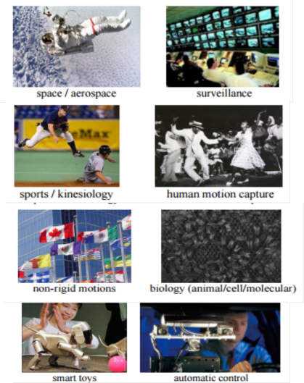
Applications
The Kalman filter has numerous applications in technology.
A common application is for guidance, navigation and control of vehicles, particularly aircraft and spacecraft.
Furthermore, the Kalman filter is a widely applied concept in time series analysis used in fields such as signal processing and econometrics.
Kalman filters also are one of the main topics in the field of robotic motion planning and control, and they are sometimes included in trajectory optimization.
The Kalman filter has also found use in modelling the central nervous system's control of movement. Due to the time delay between issuing motor commands and receiving sensory feedback, use of the Kalman filter provides the needed model for making estimates of the current state of the motor system and issuing updated commands

Slide 31
Kalman Equations
http://home.wlu.edu/~levys/kalman_tutorial/
Model
Predict
Update
The algorithm works in a two-step process. In the prediction step, the Kalman filter produces estimates of the current state variables, along with their uncertainties.
Once the outcome of the next measurement (necessarily corrupted with some amount of error, including random noise) is observed, these estimates are updated using a weighted average, with more weight being given to estimates with higher certainty.
The algorithm is recursive. It can run in real time, using only the present input measurements and the previously calculated state and its uncertainty matrix; no additional past information is required.

Slide 32
Extended Kalman Filter
The KF works if you have a linear state/system equation. That is in a KF you Start with a Gaussian assumption of your state and propagate that through your state equation to get the updated state. This can be interpreted as a linear mapping from a Gaussian space (at time k-1) to another Gaussian space (at time k). So, the linearity of the system ensures that the distribution of your estimate remains a Gaussian at all times.
Now, what if you have a nonlinear mapping of the state at one time step to the next? This is where the EKF comes in.
To overcome this we break the nonlinear function (say f) into small linear portions, with the slope of each small linear component determined by f'(at the most recent state value). And you then pass your Gaussian PDF by treating each of these local linearization as small KFs.
At a very high level, you break the Nonlinear function into small, local linear parts and apply a normal linear KF. That is the EKF.
This breaking of non linear system into ones is achieved by using a Taylor Series Expansion.

Slide 33
Taylor Seires

Slide 34
Taylor Series Expansion

Slide 35
Error Propagation

Slide 36
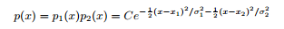
Kalman Filter derivation
Instrument 1
Instrument 2
As two measurement are independent, we can multiply their prob. distribution
Comparing this eq with std formula for Gaussian Distribution

